Slide 1
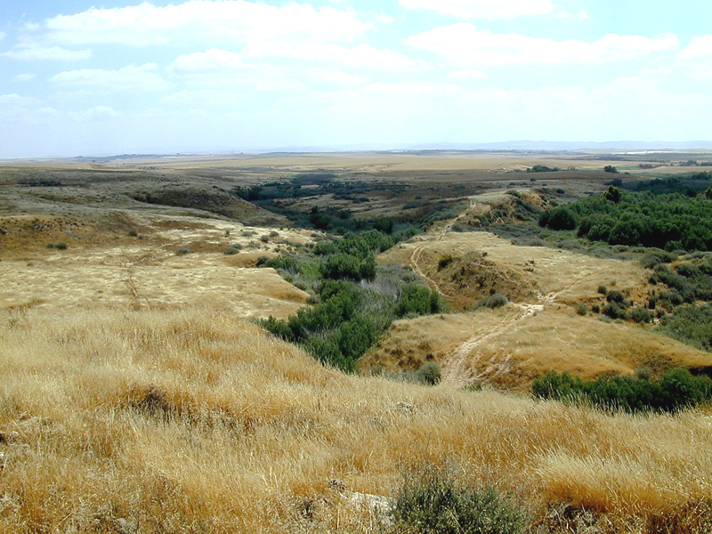
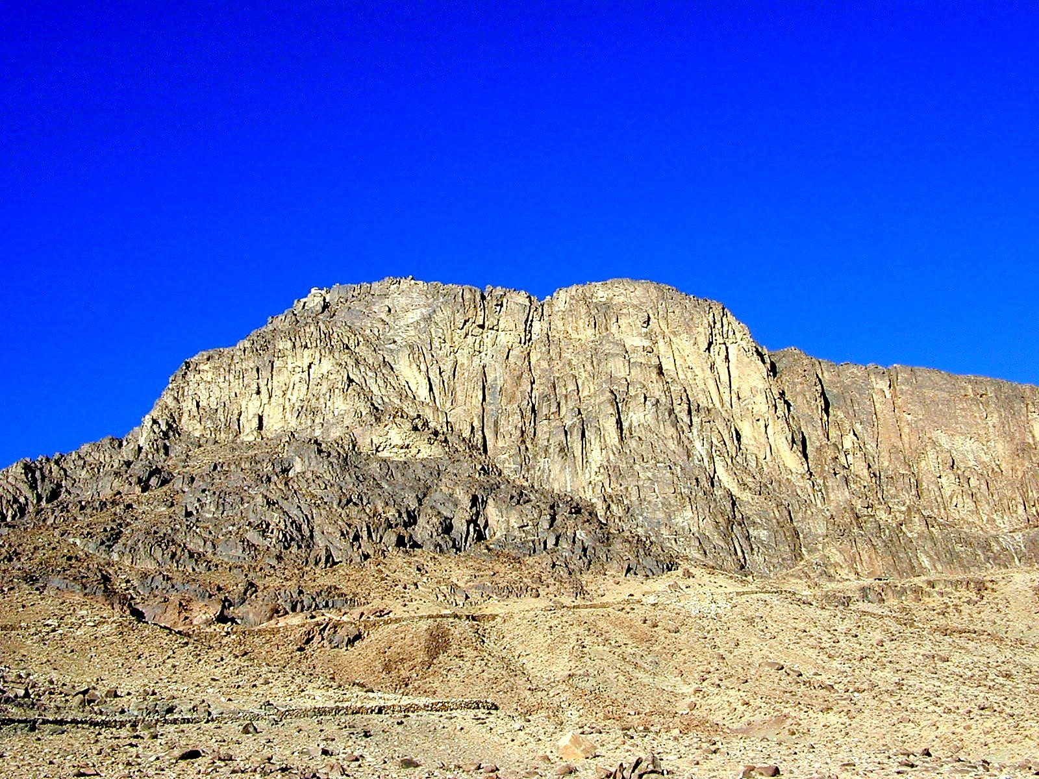
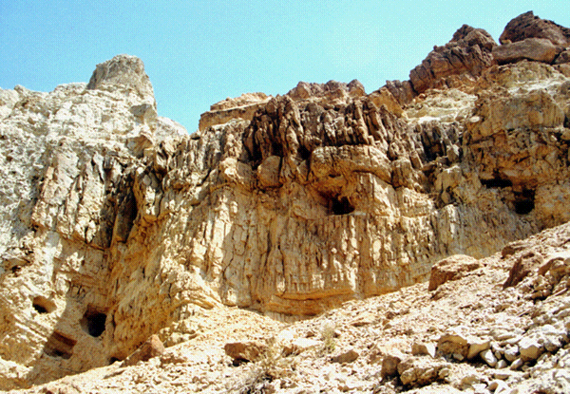
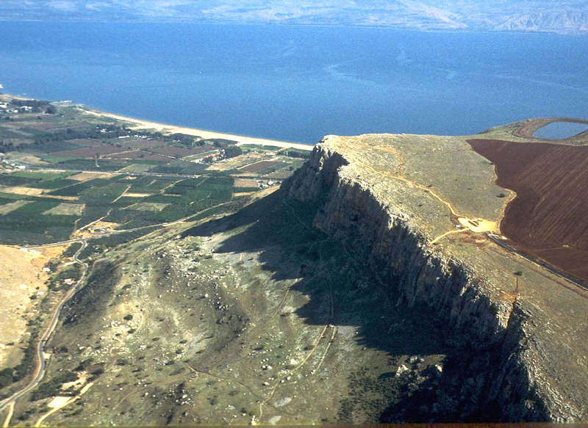
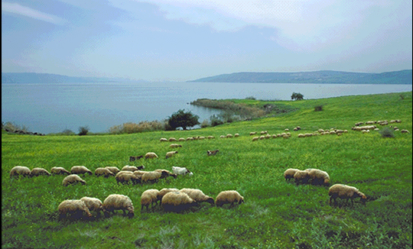
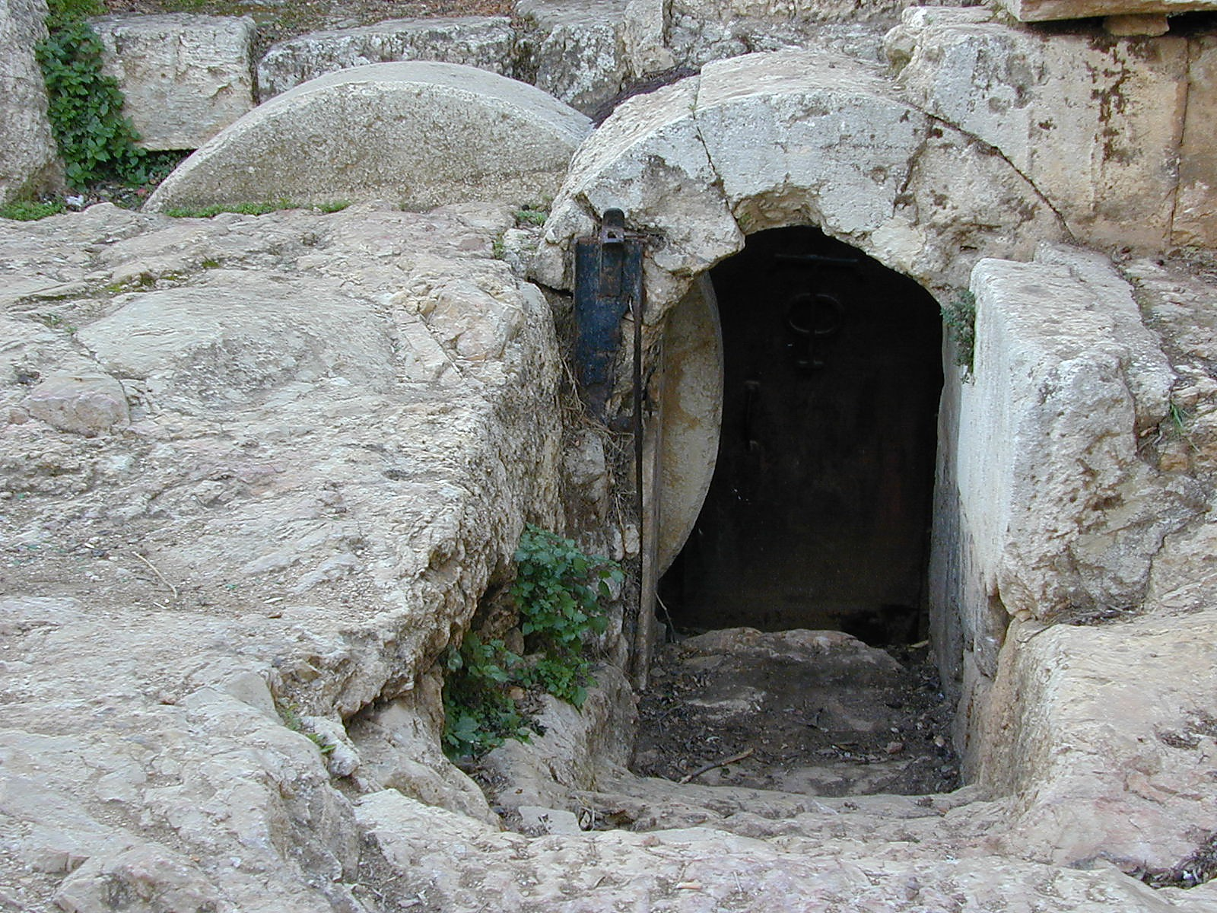
GEOGRAPHY PICTURES
BEGINNER BIBLE CURRICULUM

Slide 2
The Patriarchs

Slide 3
Nahal Gerar in the Negev
“Now Abraham journeyed from there toward the
Negev . . . then he journey in Gerar.” (20:1)

Slide 4
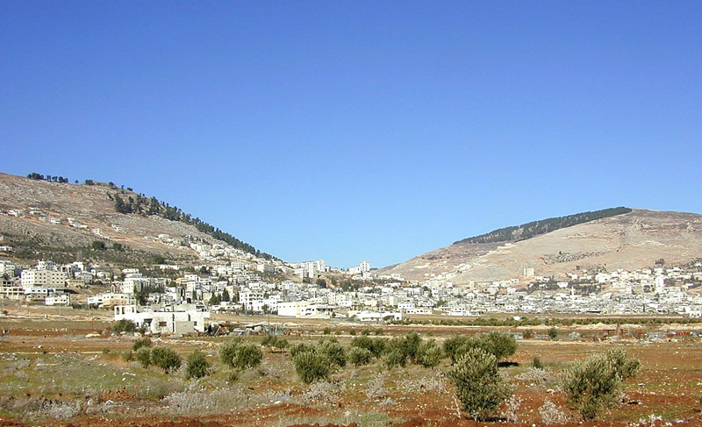
Site of Shechem (center, between Mt. Gerizim and Mt. Ebal)

Slide 5
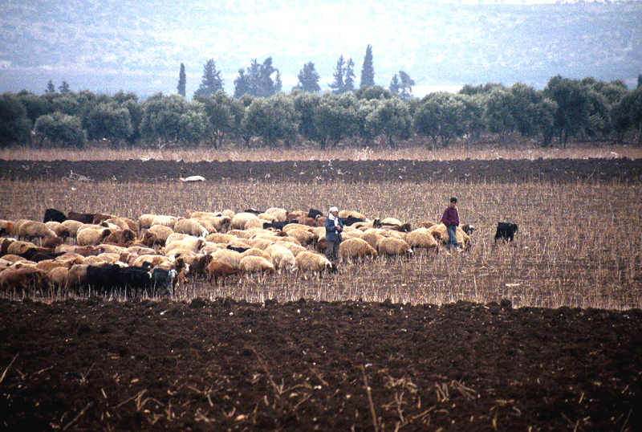
The Plain of Dothan where Joseph’s brothers were tending their flocks

Slide 6
Life of Moses

Slide 7
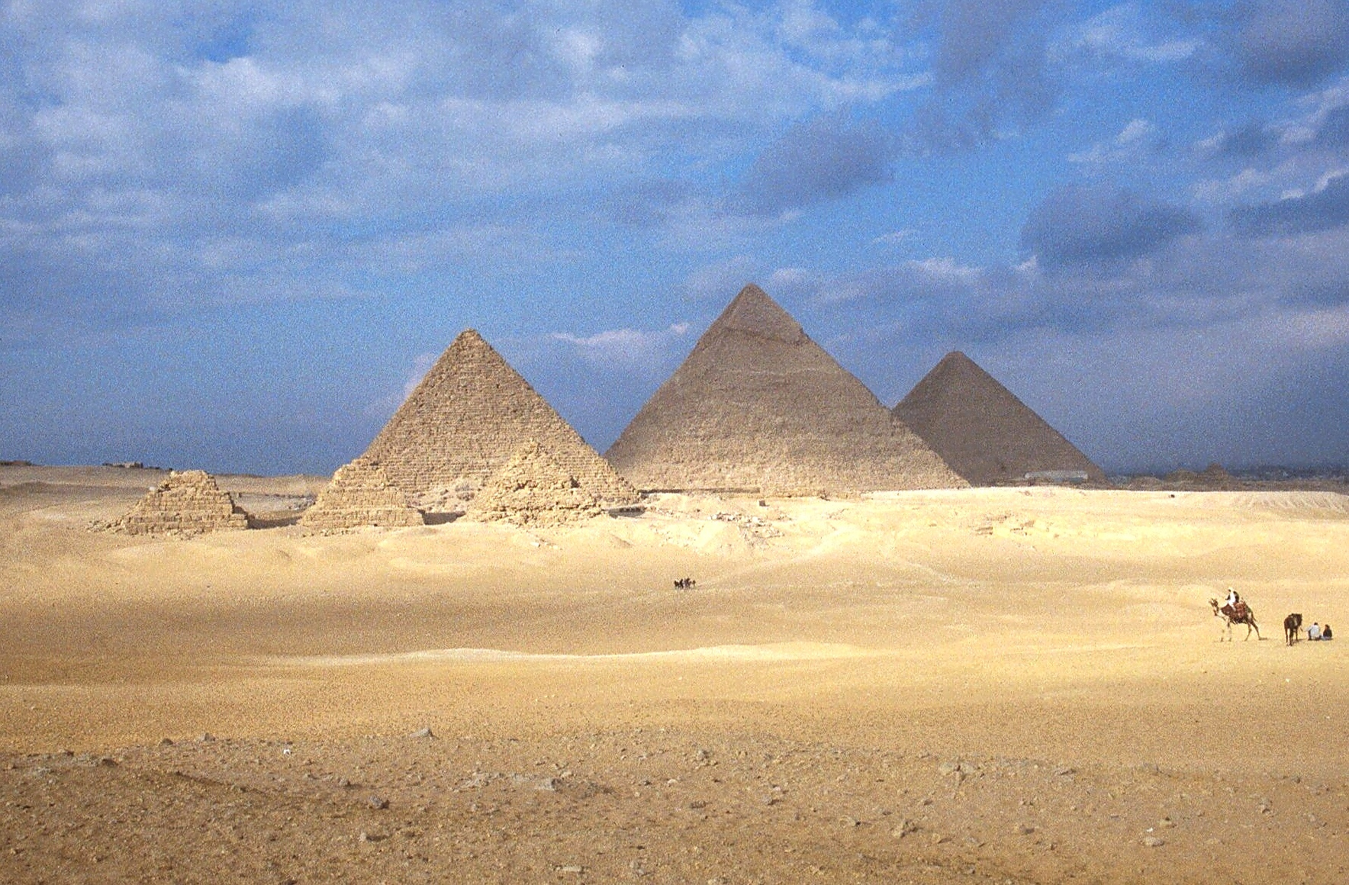
Pyramids in Egypt (from 2500 B.C.)

Slide 8
Jebel Musa
(Mt. Sinai?)

Slide 9
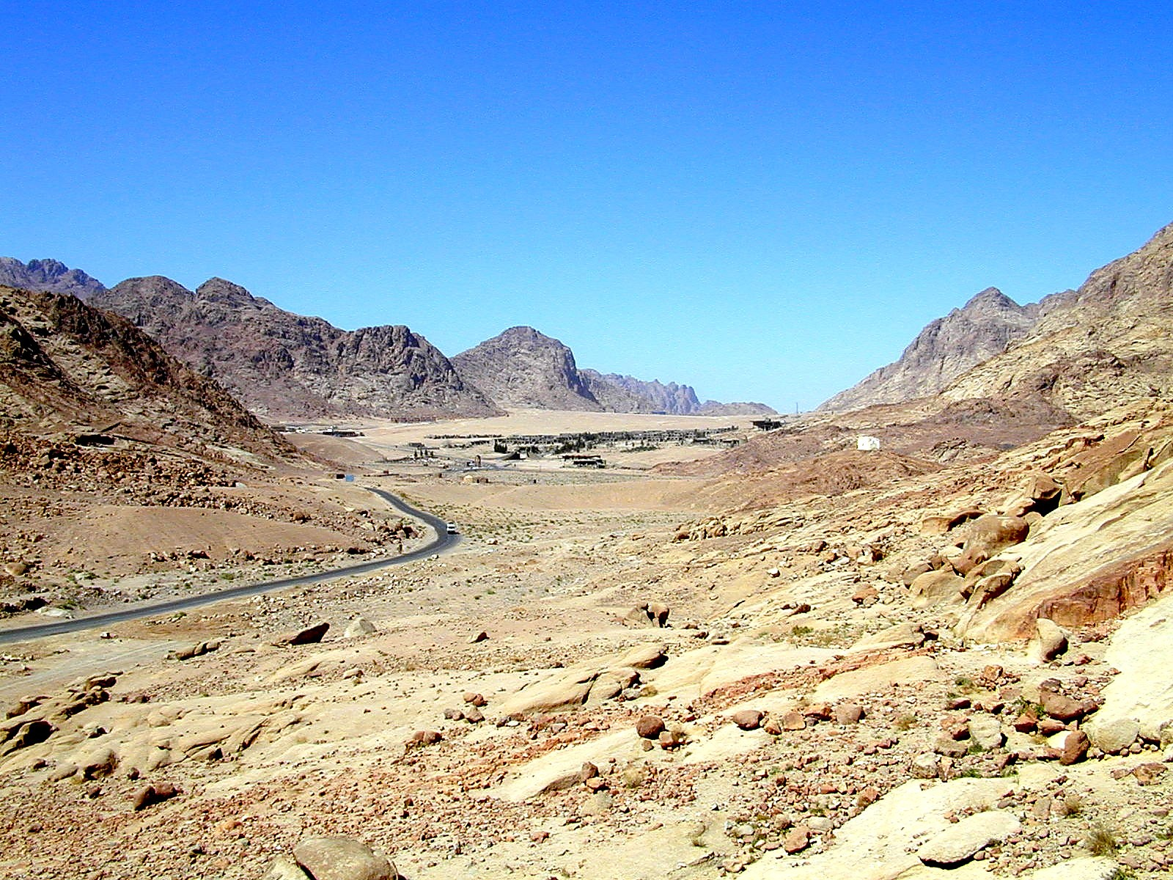
Valley of El-Raha (probable location
of Israel’s encampment at Mt. Sinai)

Slide 10
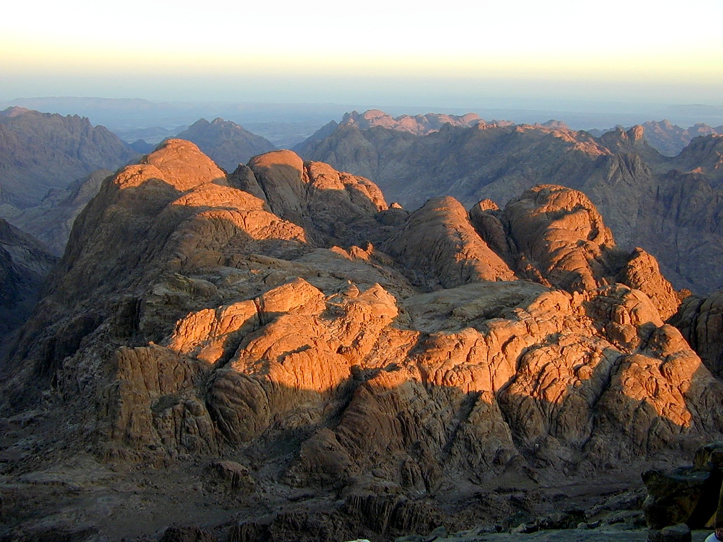
Sunrise on Jebel Musa
(Mt. Sinai?)

Slide 11
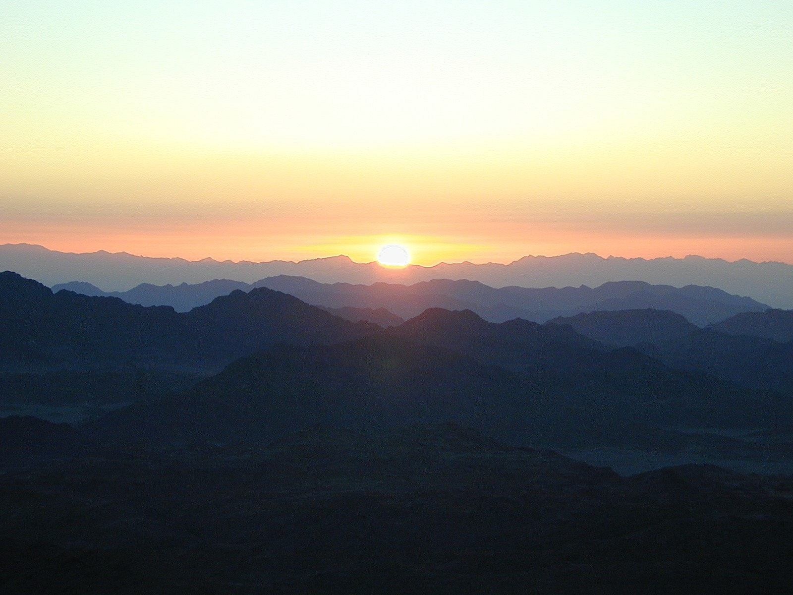
Sunset over the Sinai

Slide 12
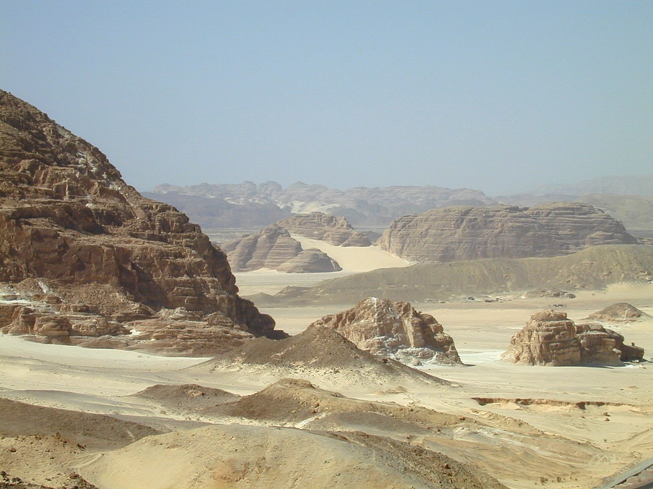
Sinai desert near Hazeroth

Slide 13
Life of David

Slide 14
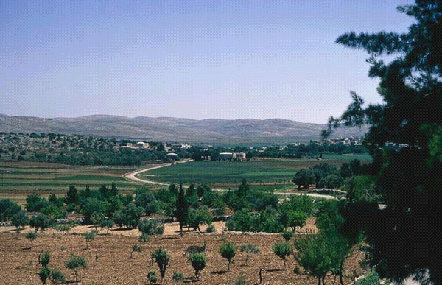
Fields south of Bethlehem

Slide 15
David was with the sheep

Slide 16
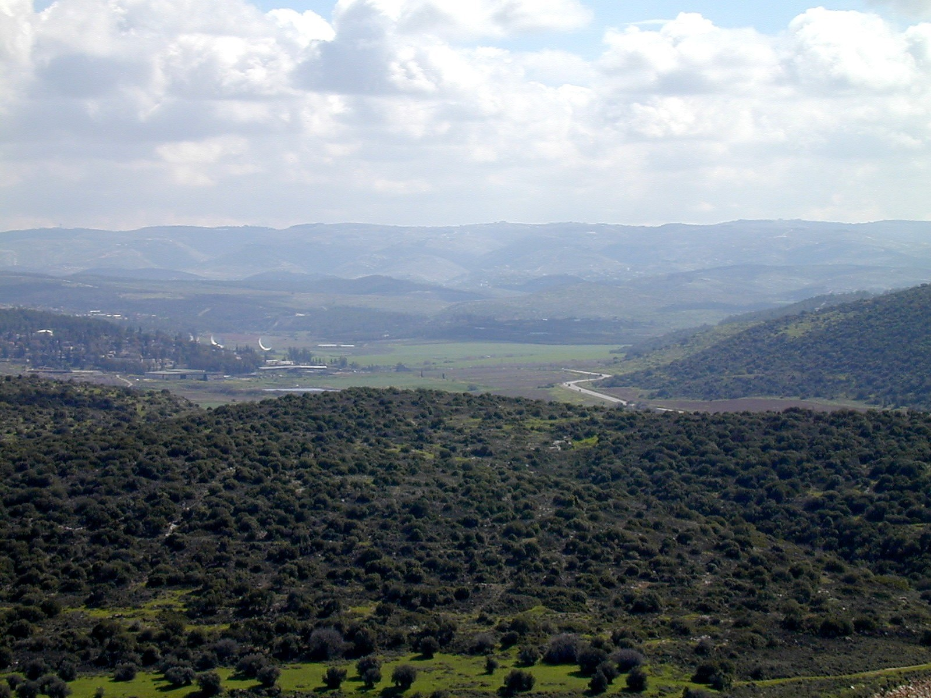
The Valley of Elah viewed eastward from Azekah
Hill Country of Judah
Saul's camp
Socoh
The gai (wide sector) of the Valley
of Elah where David met Goliath
The Philistine camp was located
between Azekah and Socoh.

Slide 17
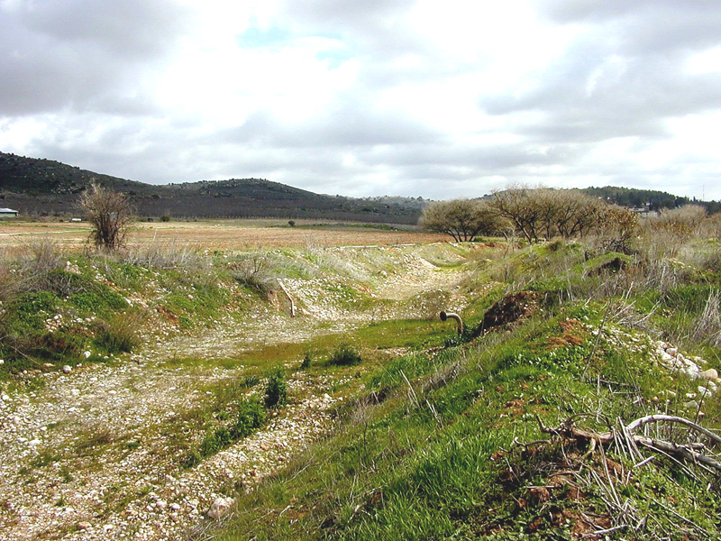
Valley of Elah
Brook of Elah

Slide 18
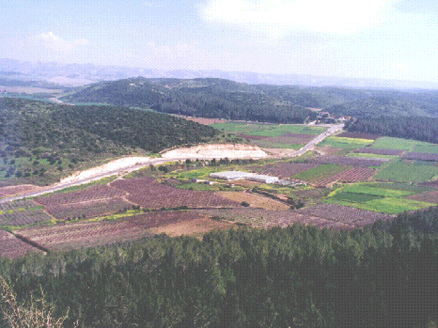
David kills Goliath.
(17:48-51)
NE
Hill Country of Judah
Israelite camp
David
Goliath
Philistine camp
Valley of Elah (viewed from Azekah)

Slide 19
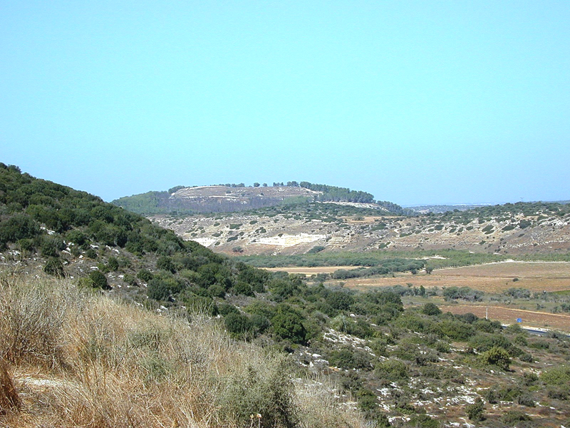
Azekah viewed westward from Socoh
Azekah:
Philistine army
Hill of Socoh
h
Saul’s army
Valley of Elah

Slide 20
Caves at
En Gedi

Slide 21
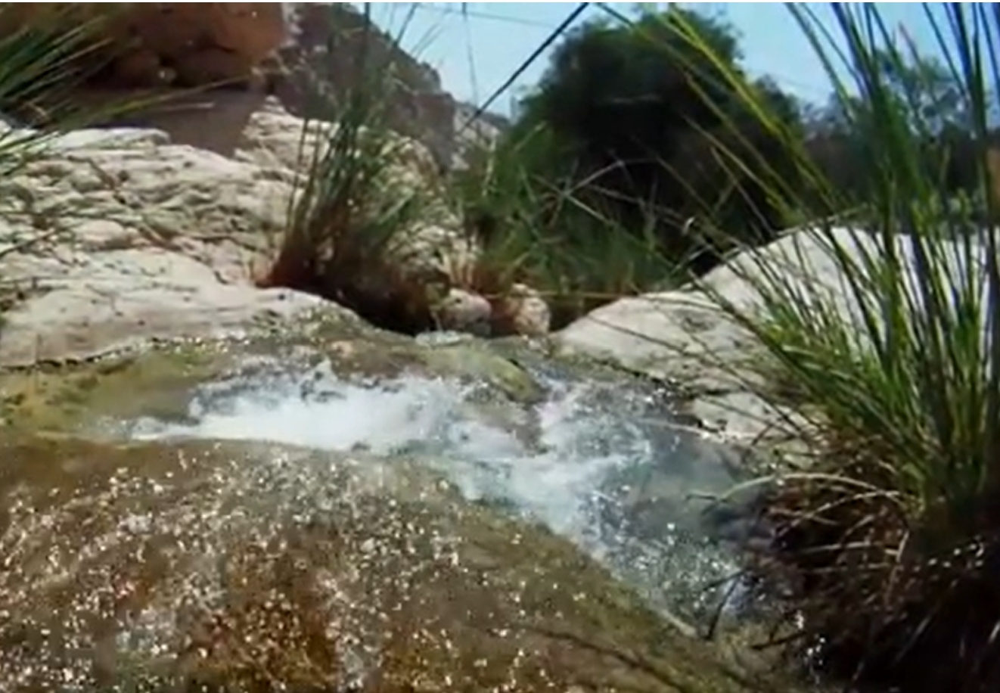
Top of waterfall at
En Gedi

Slide 22
Caves at
En Gedi

Slide 23
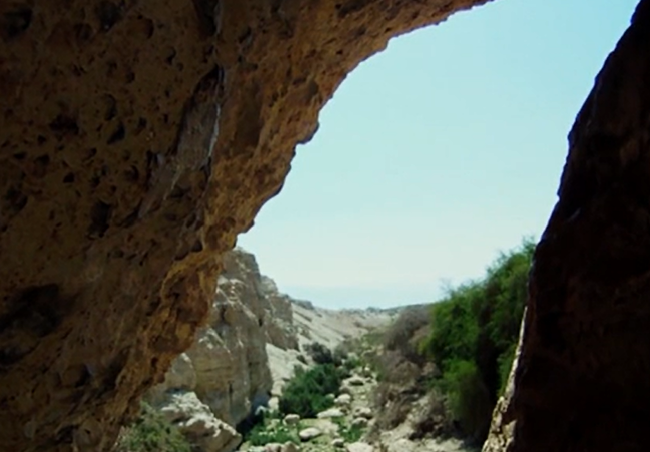
In a cave at Engedi David cut off part of Saul’s robe.
(24:1-21)

Slide 24
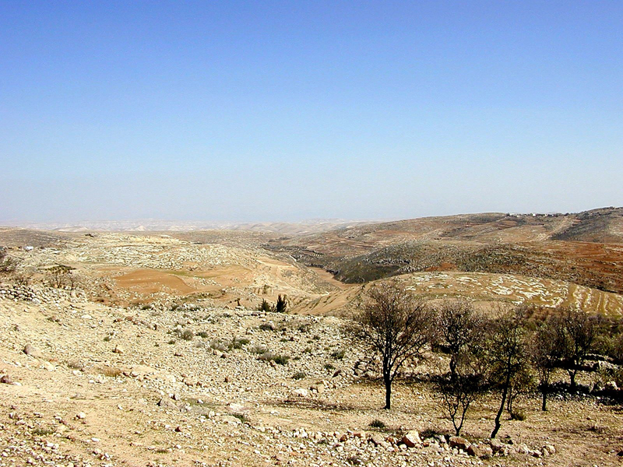
Wilderness
of Ziph

Slide 25
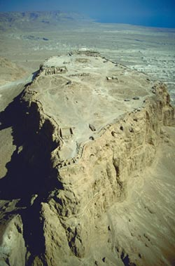
Masada
“the Stronghold”

Slide 26
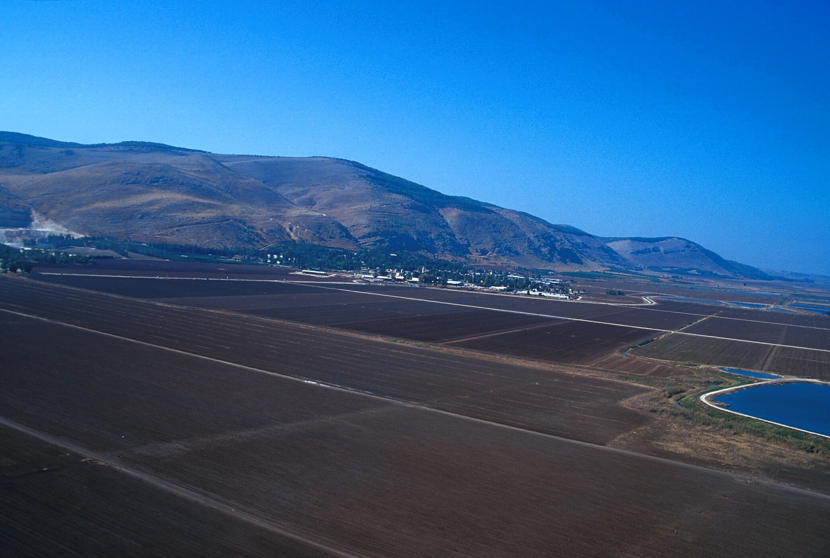
Mount Gilboa where Saul and three of his sons died in battle with the Philistines

Slide 27
Life of Jesus

Slide 28
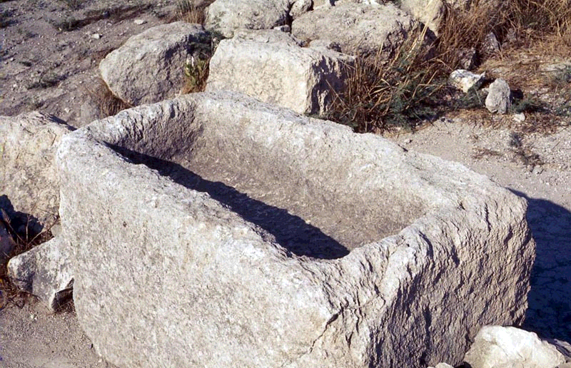
A stone
manger

Slide 29
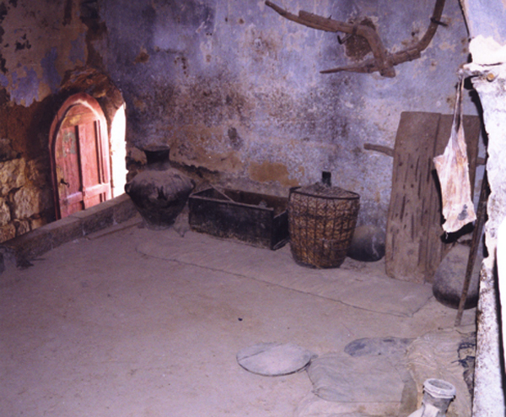
The Family Room (upper level)
Note
the stored plow and threshing sledge.

Slide 30
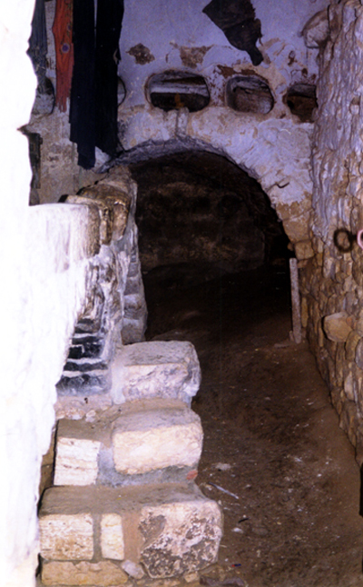
The house was large, with two levels. The door opened to a view of the lower level where the family housed animals in cold weather. Located under the family room, this room kept the home warm in winter and also served as an intruder warning system!

Slide 31
Fields south of Bethlehem
“There were some shepherds staying out in the fields . . .”

Slide 32
“. . . keeping watch over their flocks by night.”

Slide 33
The Wilderness
of Judea
“Now in those days John the Baptist came, preaching
in the wilderness of Judea, saying, ‘Repent, for the
kingdom of heaven is at hand’” (Matt 3:1,2).

Slide 34
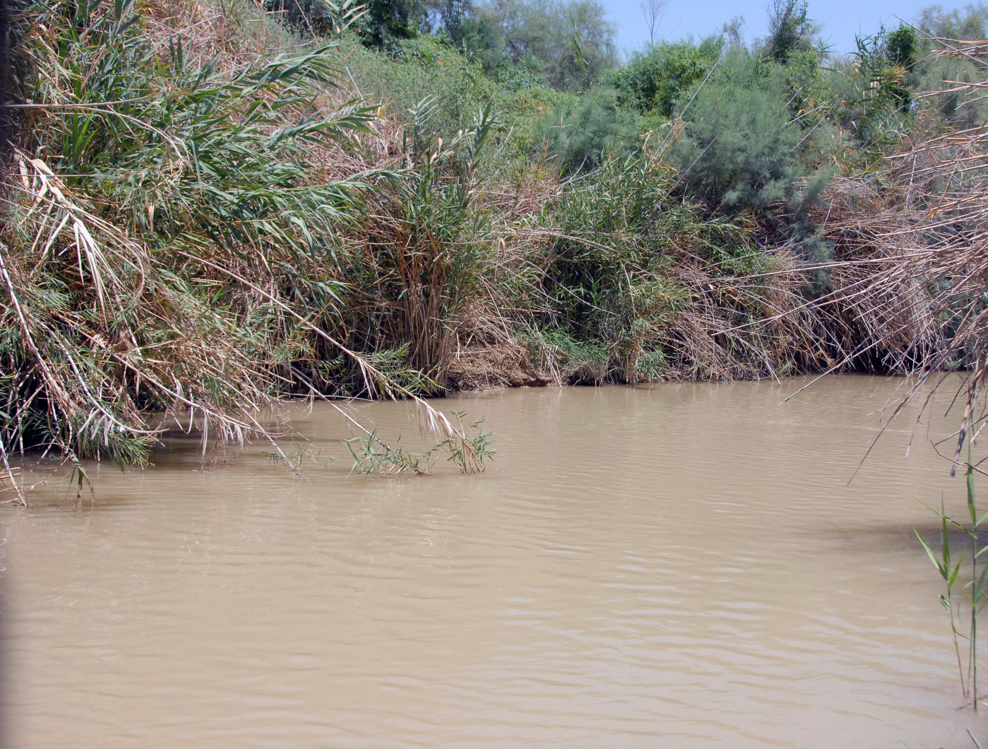
The Jordan River

Slide 35
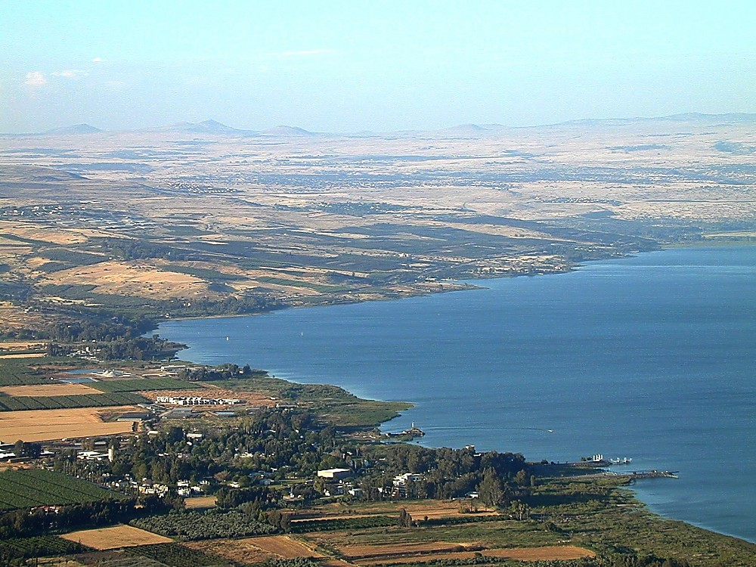
The Sea
of Galilee
Golan Heights
Bethsaida
Mt. of Beatitudes
Capernaum
Sower’s Cove
Tabgha

Slide 36
The Sea
of Galilee
Arbel Cliff
The Plain of
Gennesaret

Slide 37
The Sea of Galilee viewed from the “Sower’s Cove”

Slide 38
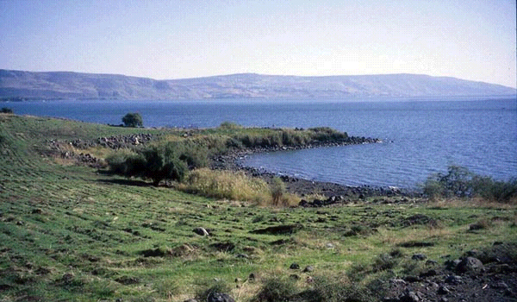
The “Sower’s Cove”
Acoustical research has demonstrated that this natural amphitheater
could have accommodated 5,000 – 7,000 people who could
easily have heard the words of a speaker on the shore or in a boat nearby.

Slide 39
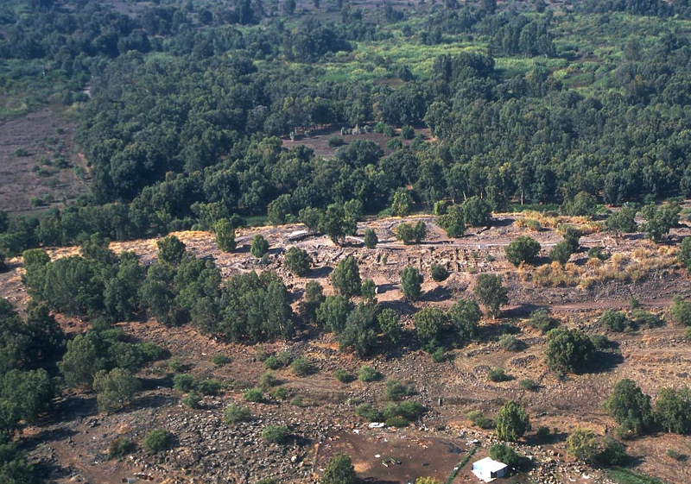
Near Bethsaida, in an uninhabited, grassy area,
Jesus fed over
five thousand people a year before His crucifixion.

Slide 40
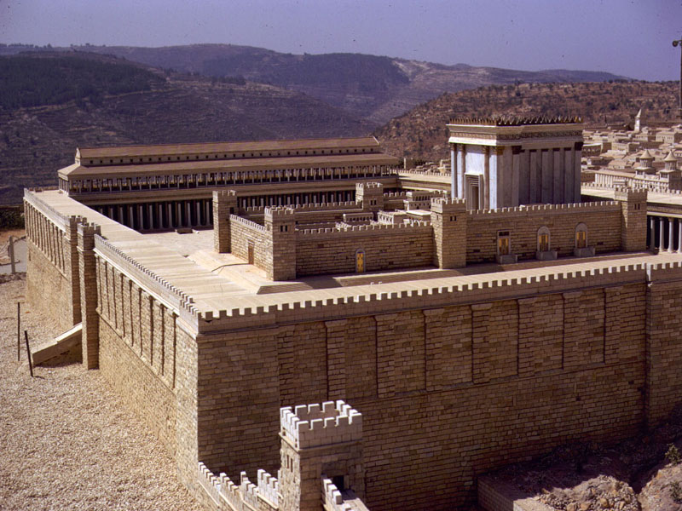
The Temple Mount
in Jerusalem
Photograph courtesy of the
Holyland Hotel Jerusalem,
location of the model

Slide 41
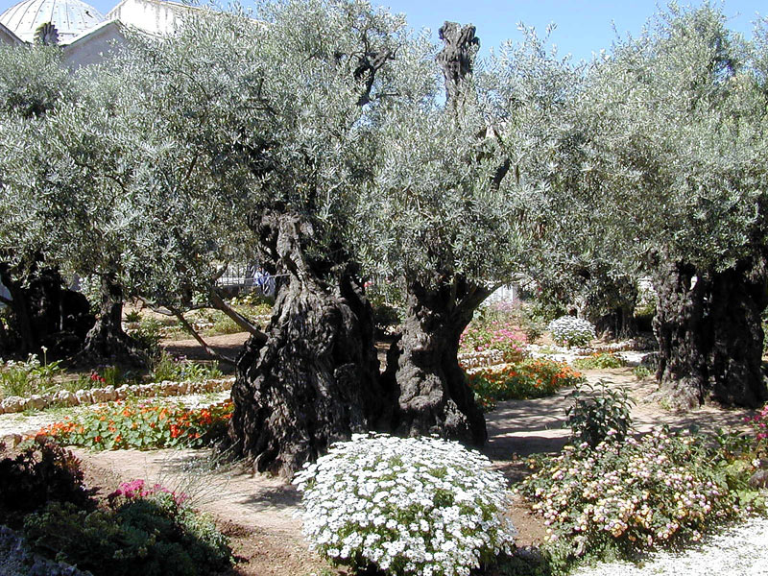
The “Garden of Gethsemane”

Slide 42
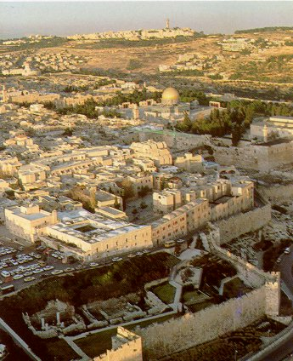
Herod’s Palace
was probably
the location of
the Praetorium
where Pilate
resided during
Passover
A.D. 30.
Mt.of Olives
Site of the temple
Site of Herod’s Palace,
built by Herod the Great.

Slide 43
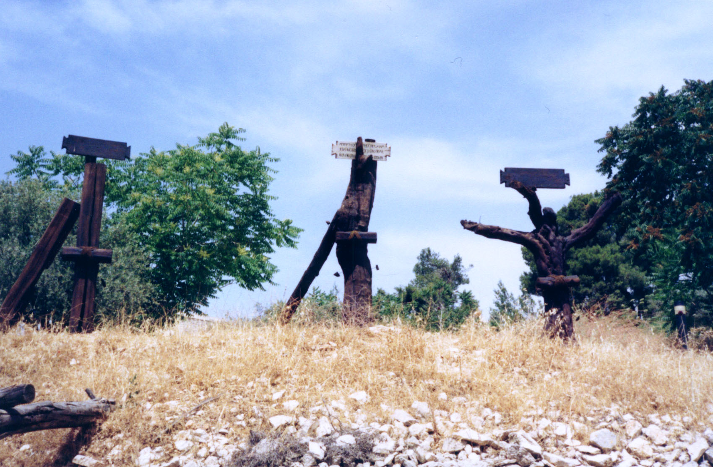
“And when they came to the place called The Skull,
there they crucified Him, and the criminals, one on
the right and the other on the left” (Luke 23:33).

Slide 44
“Simon Peter therefore also came, following him, and entered the tomb; and he beheld the linen wrappings lying there, and the face-cloth, which had been on His head, not lying with the linen wrappings, but rolled up in a place by itself.”
(John 20:6, 7)

Slide 45
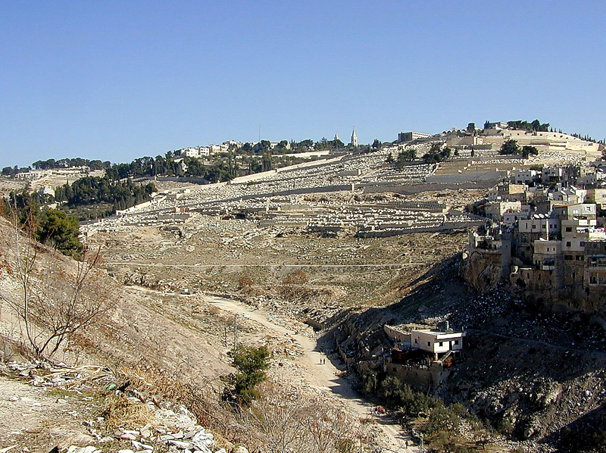
“And it came about that while
He was blessing them,
He parted from them.”
“This Jesus, who has been taken up
from you into heaven, will come in just
the same way as you have watched
Him go into heaven” (Acts 1:11).
The Mount of Olives

Slide 46
CREDITS:
Slides are from materials developed by
Terry C. Hulbert c 2003
Used with permission
Paul

